Slide 2
How or why we need DL ? SOLVE PROBLEM → write rules → its ok if its very countable in no… → human used to write rules
PROBLEMS → maintenance of rules difficult
Writing exhaustive or awareness of exhaustive rules
Can we use computer to write exhaustive rules for us ?
ALGO (Classical ML (STATS), Modern ML (LR, Logistic Regression, DT, SVM) → This Algo not sufficient because of its low accuracy or high error rate because of less complexity in algo → it will not be able to capture all possible rules/patterns and hence we need more complex (which can capture more patterns/rules) algo → DL
DL (HUMAN BRAIN)

Slide 3
DEEP L → Complex Mechanical system
Machine == C1 + C2 + …
C = {C1, C2, …} ➔ specific function
C1+C2 ➔ desired output
NN (Neural network) =➔ Multiple Layers ➔ Each layer process info step by step. Just like stages in machine.
Input → Feature of Raw Material
Layers → Mechanical Subsystems
Output → Final Product or performance
DL ➔ design + Tuning System performs optimal …

Slide 4
BIG PICTURE
AI ➔ Entire Vehicle/ overall goal ➔ machines intelligent → WHAT TO DO ?
ML → Engine → how machine is learning from your machine data → improves accuracy
DL → Turbocharger OR Advanced Engine control → Type of ML where Data is LARGE & COMPLEX (many patterns, rules exhaustive) → handles vision or detecting defects or alignment

Slide 5
BIG PICTURE
AI ➔ Entire Vehicle/ overall goal ➔ machines intelligent → WHAT TO DO ?
Automated Inspection System
Driver Monitoring System
Intelligent manufacturing lines
ML → Engine → how machine is learning from your machine data → improves accuracy
Predict Machine Failure from past data
Fuel Efficiency prediction
Warranty claim prediction
DL → Turbocharger OR Advanced Engine control → Type of ML where Data is LARGE & COMPLEX (many patterns, rules exhaustive) → handles vision or detecting defects or alignment
Image based defect detection
Vibration Signals – Analysis
Evs – Battery health Estimation
CHOOSE DL OVER ML WHEN → Traditional ML Model fails because of complexity..
OVERFITTING/UNDERFIT .. ?

Slide 6


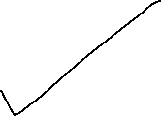



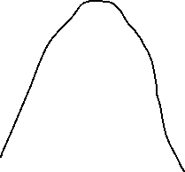




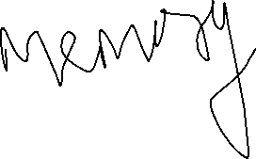

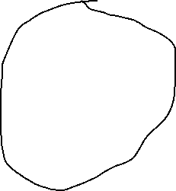

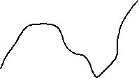







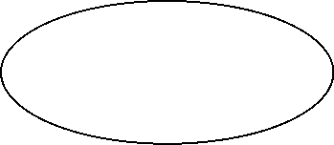


Slide 7











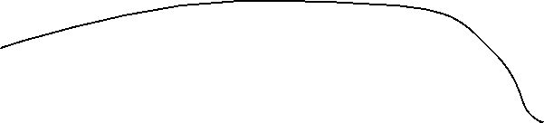









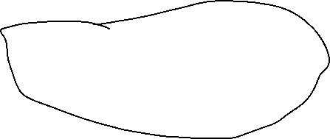











Slide 8


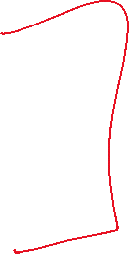

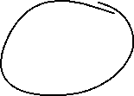

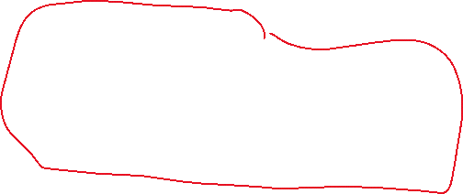



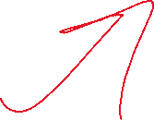





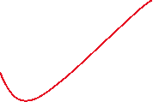


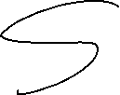



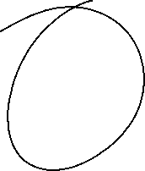


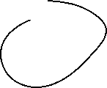


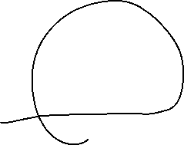

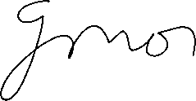


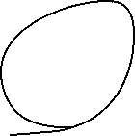





Slide 9
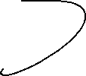



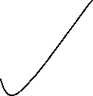






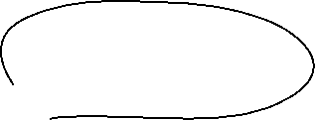


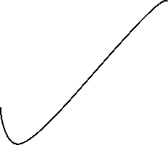













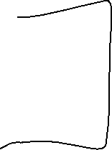



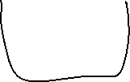





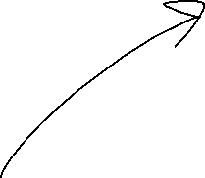






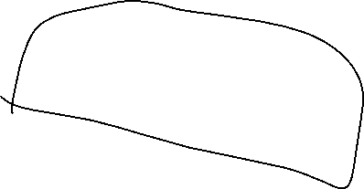









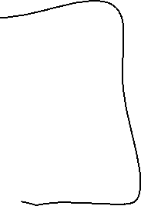


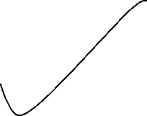


Slide 10











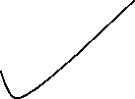



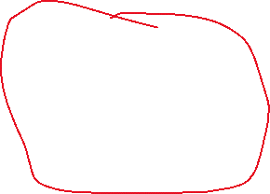


















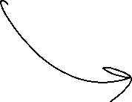



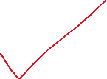

Slide 11

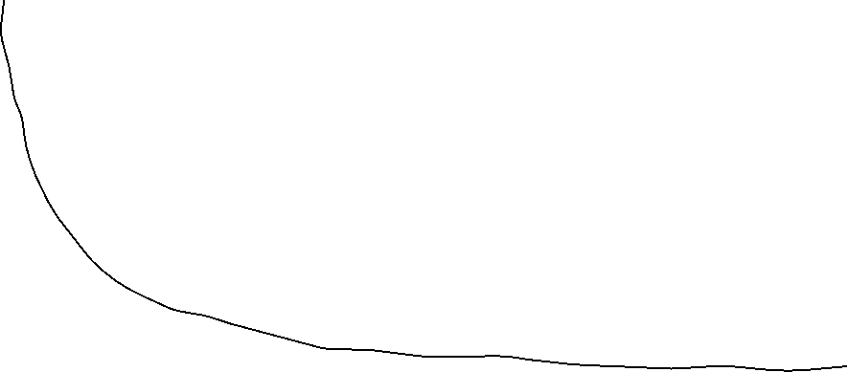


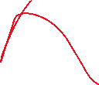



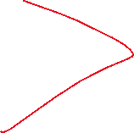
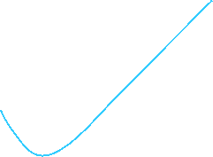


Slide 12



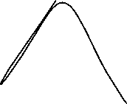
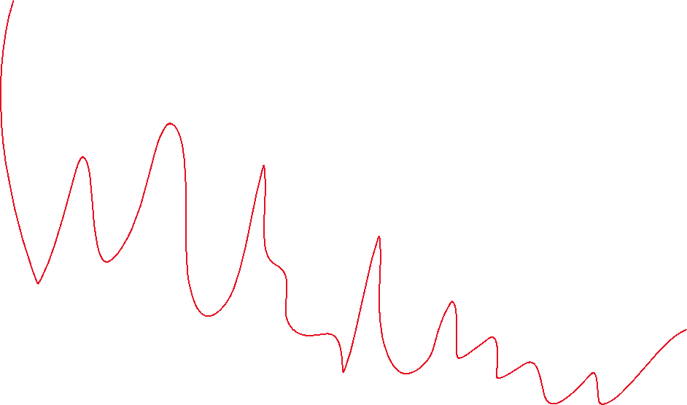




Slide 13
Numerical stability → Data is noisy ..
Data comes :
Sensors
Images
BC
DURING TRAINING (Data is very noisy)
C1: use single node in o/p layer with sigmoid function with binary cross entropy
C2: use 2 node in o/p layer with softmax function with cross entropy.

Slide 14
Numerical stability → Data is noisy ..
Gradient → not vanishing
Gradient → Not exploding
Computation → avoid overflow or underflow ..
From where instability
Exponentials
Logs
Activations → saturate
DURING TRAINING (Data is very noisy)
C1: use single node in o/p layer with sigmoid function with binary cross entropy
L = -[y log y_pred + (1-y) log (1-y_pred)]
DL/DZ == y_pred-y
Y_pred = 1/(1+e^-Z1)
Z >> 0 → y_pred ~ 1
Z <<0 → y_pred ~ 0 Log(1-y_pred) -→ log(0) → numerical underflow
C2: use 2 node in o/p layer with softmax function with cross entropy.
L = - (SUMMATION (y * Log (y_pred)))
Y_pred = e^(z1)/(e^z1 + e^z2) ➔ e^(z1 – max(Z1,Z2,Z3))/(e^(z1 – max(Z) + e^(z2 – max(Z)) ))
DL/DZ == y_pred-y

